Slide 1
DESIGN AND ANALYSIS OF ALGORITHMS
TRAVELLING
SALESMAN
PROBLEM
TSP · FINDING THE SHORTEST CLOSED TOUR

Slide 2

THE PROBLEM
FIND THE SHORTEST
CLOSED TOUR
THROUGH EVERY
CITY
Visit every city exactly once.
Return to the starting city.
Minimize total travel cost or distance.
Optimization matters because small route improvements scale across repeated journeys.

Slide 3

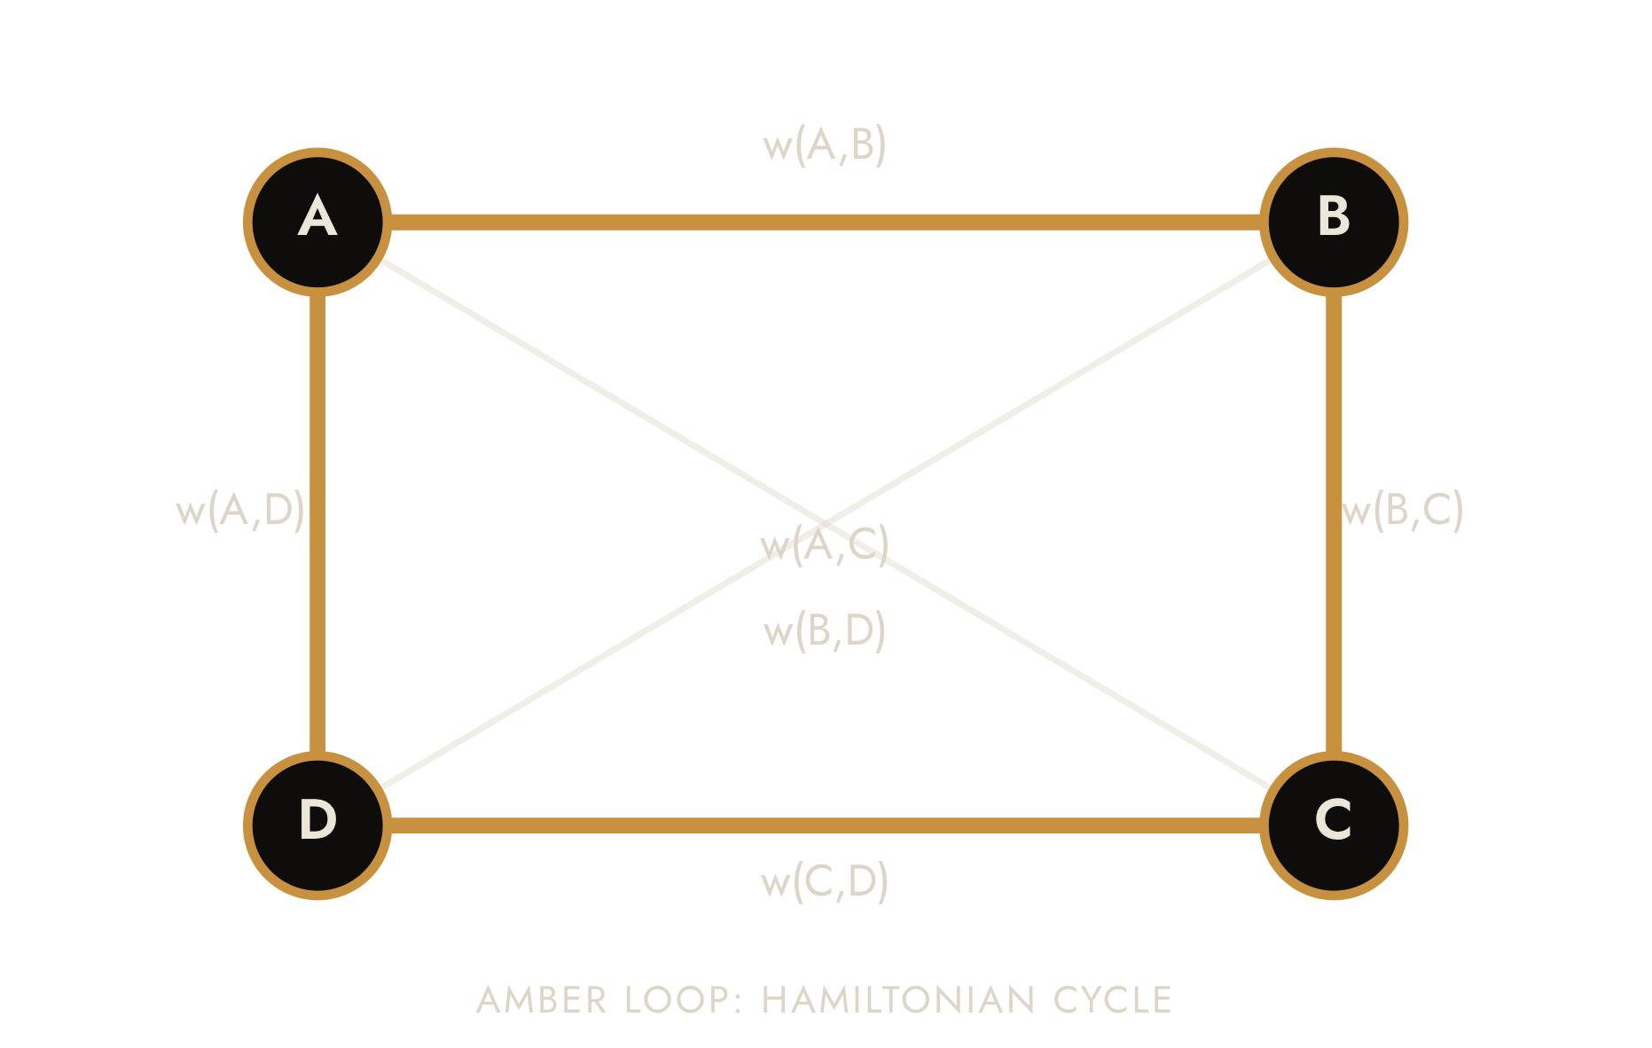




TSP IS A
WEIGHTED-GRAPH PROBLEM
Vertex
A city.
Edge
A direct connection between two cities.
Edge weight
Travel distance or cost.
Hamiltonian cycle
EACH EDGE WEIGHT REPRESENTS TRAVEL DISTANCE OR COST; THE HIGHLIGHTED CYCLE VISITS EVERY CITY ONCE AND RETURNS TO ITS START.
Visits every vertex exactly once, then returns to the start.

Slide 4





WHY IT MATTERS
ONE ROUTING PROBLEM,
MANY REAL DECISIONS
The same structure appears whenever a system must visit a collection of locations or tasks efficiently.
Delivery and logistics
Route planning
Sequence stops to reduce fleet travel.
Organize visits across a service region.
Manufacturing
Circuit-board drilling
Order jobs or tool movements efficiently.
Reduce drill-head travel between holes.
Transportation optimization
Lower distance, time, or operating cost.

Slide 5
INSTANCE
A FOUR-CITY
INSTANCE
10
A
B
Cities: A, B, C, and D.
Distances are symmetric: travelling from A to B costs the same as travelling from B to A.
20
15
25
35
C
D
30

Slide 6
COMPARE CANDIDATES
TOUR 1
TOUR 2 · MINIMUM
TOUR 2 IS THE BEST
OF THE THREE SHOWN
A → B → C → D → A
A → B → D → C → A
10 + 35 + 30 + 20 = 95
10 + 25 + 30 + 15 = 80
TOUR 3
A → C → B → D → A
The preferred tour is the one with the minimum total cost.
15 + 35 + 25 + 20 = 95
ALL DISTINCT TOURS HAVE BEEN CONSIDERED. THE MINIMUM COST IS 80 FOR A-B-D-C-A.

Slide 7
PSEUDOCODE · FIXED START CITY
EXACT METHOD
BRUTE FORCE:
ENUMERATE, EVALUATE, CHOOSE
bestCost ← ∞
bestTour ← ∅
for each permutation P of C \ {Start}:
tour ← (Start, P₁, …, P_(n−1), Start)
cost ← Σᵢ₌₁ⁿ w(tourᵢ, tourᵢ₊₁)
if cost < bestCost then
bestCost ← cost
bestTour ← tour
return bestTour, bestCost
For a small instance, test every candidate tour and keep the cheapest one.
Generate possible tours.
Calculate each tour's total cost.
Compare all costs.
Select the minimum-cost tour.
THE NUMBER OF TOURS GROWS RAPIDLY AS THE NUMBER OF CITIES INCREASES.

Slide 8

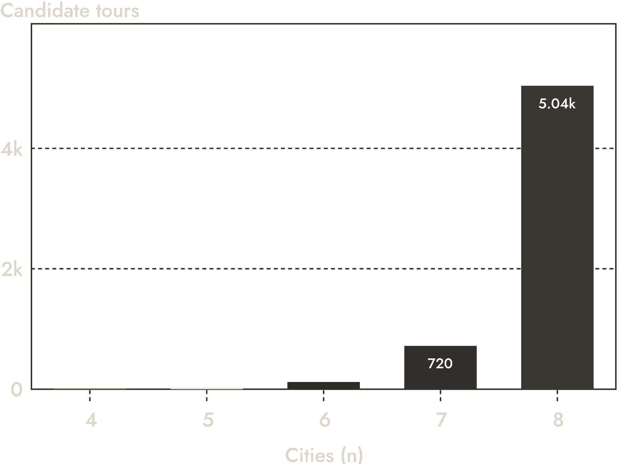
THE BOTTLENECK
CANDIDATE TOURS WITH ONE FIXED START
FACTORIAL GROWTH
OVERWHELMS
BRUTE FORCE
With a fixed starting city, candidate tours are approximately (n − 1)!; a simplified brute-force description is O(n!).
As n grows, exhaustive evaluation becomes impractical.

Slide 9
COMPUTATIONAL COMPLEXITY
TSP IS
COMPUTATIONALLY DIFFICULT
The wording of the question changes the complexity classification.
OPTIMIZATION VERSION
DECISION VERSION
Find the minimum-cost tour.
Is there a tour with cost at most K?
NP-hard
NP-complete
The task asks for the best solution.
The task asks for a yes-or-no answer.
These classifications describe computational difficulty, not a proof that no efficient algorithm can ever exist.

Slide 10

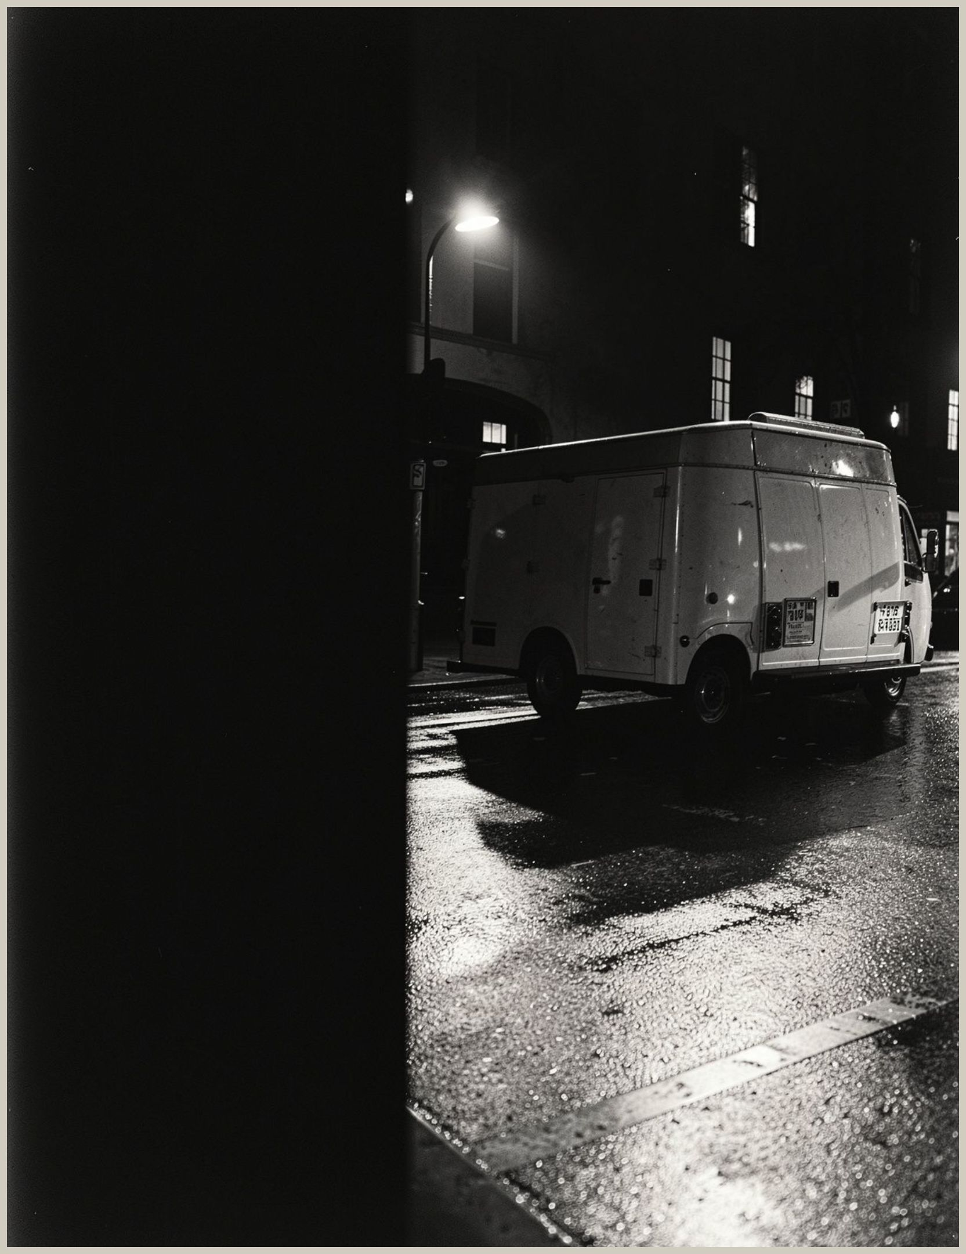
TAKEAWAY
FROM CITY ROUTES
TO ALGORITHMIC INSIGHT
Simple to state,
powerful to model,
difficult to scale.
GENERATED USING GAMMA AI

